Slide 1
Discrete Mathematics BCSC 0010 Module 2 Predicate logic
(Translating from English into Logical Expressions)

Slide 2
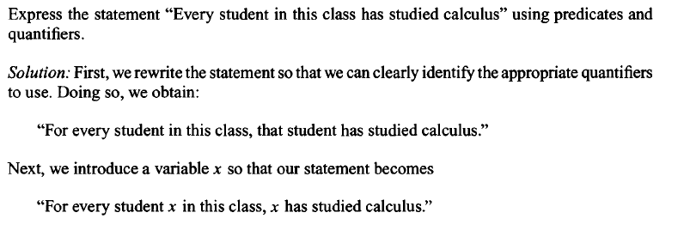
Translating from English into Logical Expressions

Slide 3
Contd..

Slide 4
Example

Slide 5
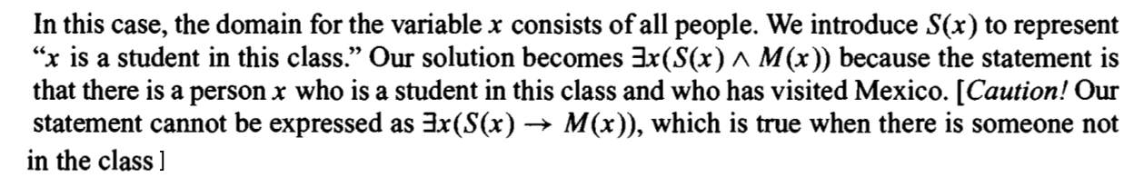
Contd..

Slide 6

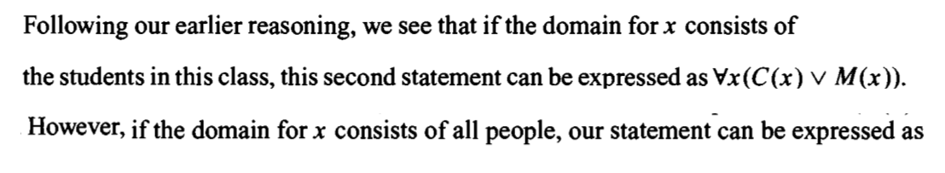
Contd..

Slide 7
Contd..

